Slide 1


Slide 2

Supply Chain
North - America - Retails - Sales Analysis

Slide 3
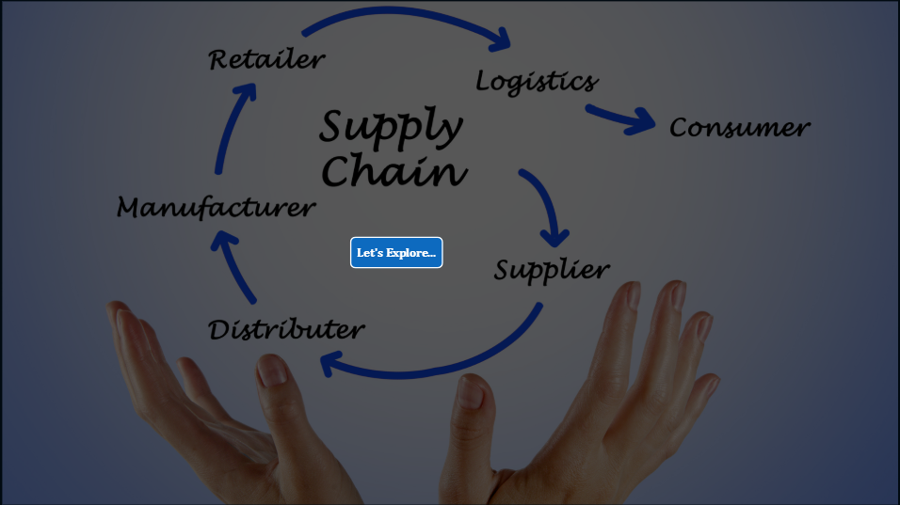
Supply Chain
Problem: Lack of visibility and performance tracking across the supply chain.
Presenter's Name :
Solution: A comprehensive Power BI dashboard to track sales, profit, returns, and orders.
Unique Value: Region-wise, state-wise, and sub-category insights powered by DAX, enabling data-driven decisions
Mohamed Khallaf
Mohamed Naser
Ahmed Gharib
Khaled Meligy
Date: April 2025

Slide 4
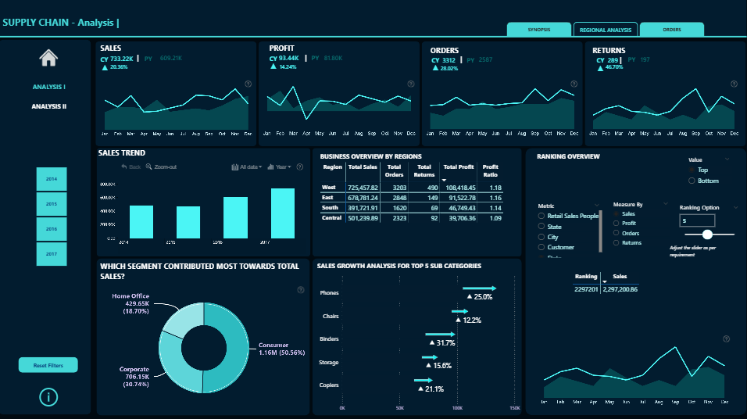
Problem: Lack of visibility and performance tracking across the supply chain.
Supply Chain – Analysis I Overall, Sales & Performance
Sales (Current Year - CY): $733.22K (↑20.36% from PY)
Profit: $93.44K (↑14.24%)
Orders: 3,312 (↑28.02%)
Returns: 289 (↑46.7%)
Sales Trend: Positive Growth over 4 years, especially strong in 2017.
Highest Sales Region: West ($725.45K), followed by East.
Top Contributing Segment:
Consumer Segment (Texas).
Top Performing State: California with $457.68K in sales.
Actions:
Focus efforts on the West and East regions.
Increase support and inventory for consumer segment.
Investigate the cause behind high returns (↑46.7%) to reduce loss.
Solution: A comprehensive Power BI dashboard to track sales, profit, returns, and orders.
Unique Value: Region-wise, state-wise, and sub-category insights powered by DAX, enabling data-driven decisions

Slide 5
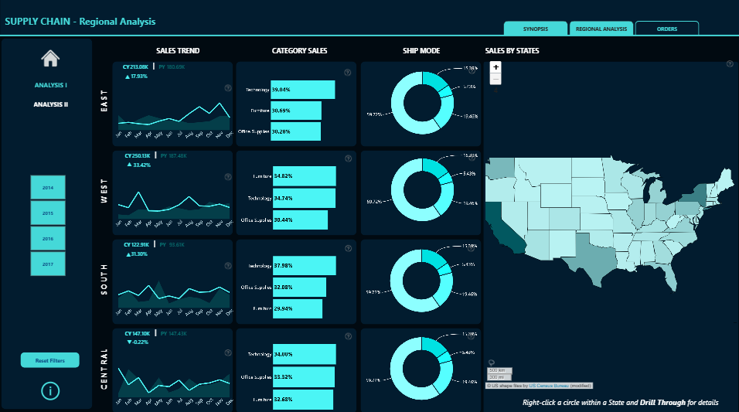
Supply Chain – Analysis I Overall, Sales & Performance
Sales (Current Year - CY): $733.22K (↑20.36% from PY)
Profit: $93.44K (↑14.24%)
Orders: 3,312 (↑28.02%)
Returns: 289 (↑46.7%)
Sales Trend: Positive Growth over 4 years, especially strong in 2017.
Highest Sales Region: West ($725.45K), followed by East.
Top Contributing Segment:
Consumer Segment (Texas).
Top Performing State: California with $457.68K in sales.
Actions:
Focus efforts on the West and East regions.
Increase support and inventory for consumer segment.
Investigate the cause behind high returns (↑46.7%) to reduce loss.
Dashboard 2
SUPPLY CHAIN - Regional Analysis
Product Category Performance :
Technology: Leading category across multiple regions.
Sales & Profits: Sales & Profits per Region
Actions:
Diversify offerings in Furniture and Office Supplies based on region preferences.

Slide 6
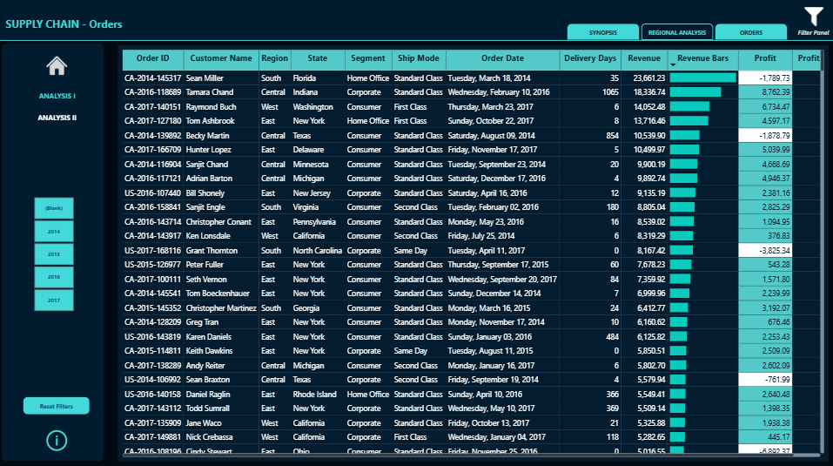
Dashboard 2
SUPPLY CHAIN - Regional Analysis
Product Category Performance :
Technology: Leading category across multiple regions.
Sales & Profits: Sales & Profits per Region
Actions:
Diversify offerings in Furniture and Office Supplies based on region preferences.
Dashboard 3
SUPPLY CHAIN - Orders
Orders Metrix
Shows each order’s details: Order ID, Customer, Region, Ship Mode, Order Date, Delivery Days, Revenue, Profit,
Actions:
Identify unprofitable orders and products.
Track high-value customers and products.
Monitor supply chain efficiency. Improve slow deliveries.
Optimize usage of faster or cost-effective shipping.

Slide 7
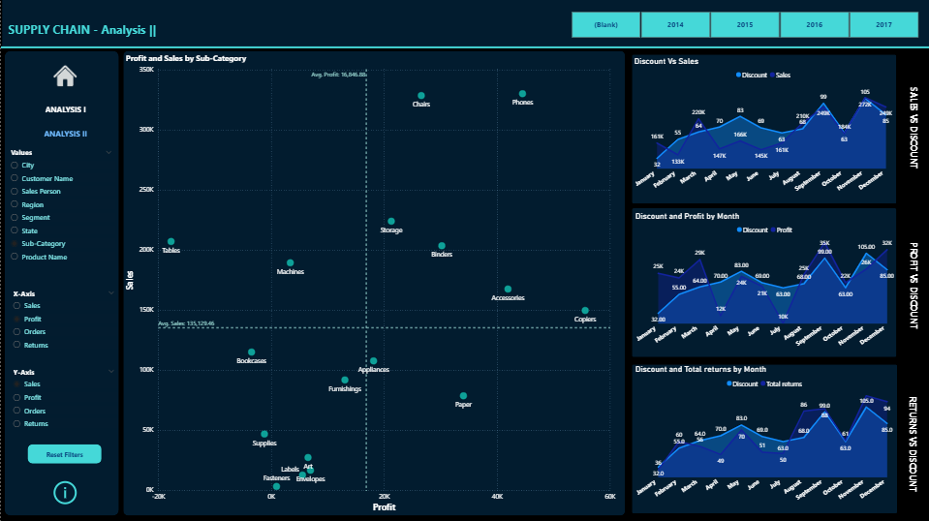
Dashboard 4
SUPPLY CHAIN - Analysis ||
Scatter Plot ( Profit vs. Sales by Sub-Category )
Line Chart:
Discount vs. Total Returns per Month
Discount vs. Profit per Month
Discount vs. Sales per Month
Actions:
Products like Tables have high sales but low or negative profit → Optimize pricing or cost.
Phones and Chairs are both high sales + high profit → Focus more marketing efforts here.
Dashboard 3
SUPPLY CHAIN - Orders
Orders Metrix
Shows each order’s details: Order ID, Customer, Region, Ship Mode, Order Date, Delivery Days, Revenue, Profit,
Actions:
Identify unprofitable orders and products.
Track high-value customers and products.
Monitor supply chain efficiency. Improve slow deliveries.
Optimize usage of faster or cost-effective shipping.

Slide 8
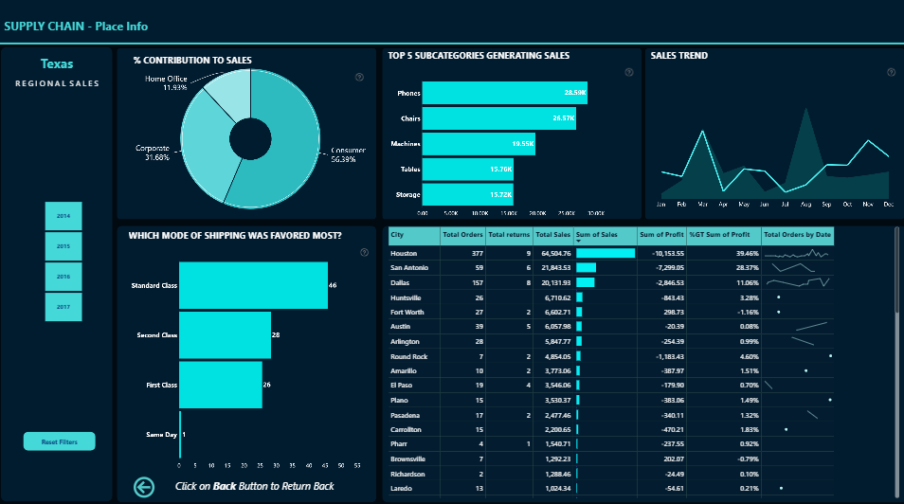
Dashboard 4
SUPPLY CHAIN - Analysis ||
Scatter Plot ( Profit vs. Sales by Sub-Category )
Line Chart:
Discount vs. Total Returns per Month
Discount vs. Profit per Month
Discount vs. Sales per Month
Actions:
Products like Tables have high sales but low or negative profit → Optimize pricing or cost.
Phones and Chairs are both high sales + high profit → Focus more marketing efforts here.
Dashboard 5
SUPPLY CHAIN - Place Info
Sales Distribution by Segment:
Consumer: 55.72%
Corporate: 29.58%
Home Office: 14.69%
Top 5 Subcategories:
Phones, Bookcases, Chairs, Storage, Tables.
Preferred Shipping Mode: Standard Class
Top Performing Cities:
Houston (14.1K sales), followed by Dallas and San Antonio.
Cities with Negative Profit: Amarillo, Lubbock, Dallas
Actions:
Continue to push Phones and Furniture subcategories.
Address profitability in Dallas and Amarillo – possible high return or shipping costs.
Improve shipping efficiency – explore cost-effective alternatives to Standard Class.
Increase focus on high-potential cities like Houston for campaigns.

Slide 9
End Users & Features
Dashboard 5
SUPPLY CHAIN - Place Info
Sales Distribution by Segment:
Consumer: 55.72%
Corporate: 29.58%
Home Office: 14.69%
Top 5 Subcategories:
Phones, Bookcases, Chairs, Storage, Tables.
Preferred Shipping Mode: Standard Class
Top Performing Cities:
Houston (14.1K sales), followed by Dallas and San Antonio.
Cities with Negative Profit: Amarillo, Lubbock, Dallas
Actions:
Continue to push Phones and Furniture subcategories.
Address profitability in Dallas and Amarillo – possible high return or shipping costs.
Improve shipping efficiency – explore cost-effective alternatives to Standard Class.
Increase focus on high-potential cities like Houston for campaigns.
Key Features: Region and state-level breakdown Sub-category sales growth analysis Delivery and return tracking Ranking by performance (Top N)
End Users :
Supply Chain Analyst. Sales Managers Executives.

Slide 10


End Users & Features
End Users :
Supply Chain Analyst. Sales Managers Executives.
Key Features: Region and state-level breakdown Sub-category sales growth analysis Delivery and return tracking Ranking by performance (Top N)

Slide 11

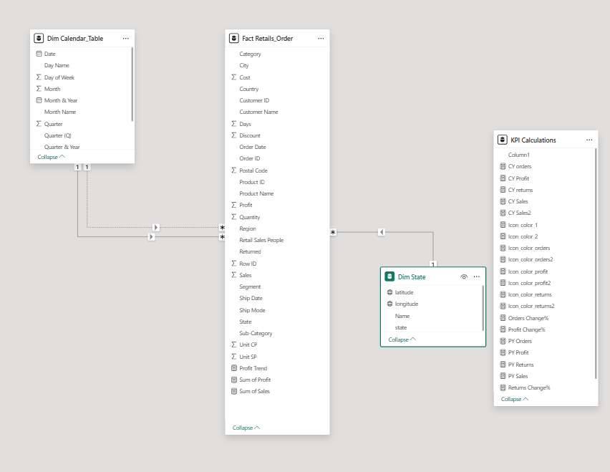
Star Schema
Languages/Tools
Python ( Data Explorations )
Power BI Desktop
Power Query M
DAX (Data Analysis Expressions)
Frameworks
:
CSV datasets
Power BI Service (for publishing)
Technologies

Slide 12
Languages/Tools
Python ( Data Explorations )
Power BI Desktop
Frameworks
Power Query M
DAX (Data Analysis Expressions)
:
Technologies
CSV datasets
Power BI Service (for publishing)

Slide 13
Live Application:
Hosted on Power BI Desktop (published to Power BI Service for sharing)
Testing:
Unit Testing: DAX formula checks
Integration Testing: Data relationships and filter context
User Testing: Collected internal team feedback for improvements

Slide 14
Final Outputs:
Power BI Dashboard (.pbix file)
Final Report (PDF)
Presentation (PPT)
Timeline:
Data preparation: Feb 2025
Dashboard creation: March 2025
Report & PPT finalization: April 2025

Slide 15
Mohamed Magdy (Team Leader) - Responsible for creating DAX Measures.
Ahmed Ghareeb - Responsible for Data Cleaning and Data Transformation.
Khalid Meligy - Responsible for Data Modelling and Data Validation.
Mohamed Naser - Responsible for Data Visualization & Report creation

Slide 16


